Slide 1

National Resource Allocation Formula
Technical Advisory Group on Resource Allocation
9th February 2016
Paudric Osborne
Lynne Jarvis

Slide 2
Outline:
Purpose
Structure
      Age and sex component
      Morbidity & life circumstances component
      Unavoidable excess cost component
Outputs
Development of the formula

Slide 3
Purpose: ...
To calculate health board target shares
Covering hospital and community health services and prescribing
Allowing for equitable access to health care resources
Given relative morbidity
And the relative costs of delivering services

Slide 4
Structure: overview
Uses a weighted capitation approach
Fundamental starting point is (resident) population
Weighted to reflect need for, and cost of, services
Product of components generates target shares
Calculated by care programme (& diagnostic group)
Need
Unit Cost
NRS
Resident
Population
Age
& sex
index
Morbidity
& Life Cs
index
Excess
Cost
Index
Target
Share
%
X
X
X
⇨

Slide 5
Structure: care programme weights
Care programme | Weights (%)
Hospital, Community and Public Health Services |  | 87%
Acute | 51%
Care of the Elderly | 3%
Mental Health and Learning Difficulties | 11%
Maternity | 4%
Community – travel based | 12%
Community – clinic based | 6%
Prescribing |  | 13%
Total |  | 100%
Circulatory;
Cancer;
Respiratory;
Digestive system;
Injuries and poisoning;
Acute outpatients
Other.

Slide 6
Structure: data and costing
Built up using small area information
Basic geographical unit is the data zone (or IG)
Cost data taken from the Costs Book
Activity data taken from the Scottish Morbidity Records
National average unit costs for an episode of care
Local unit costs for an episode of care
Unit costs calculated by speciality
Case mix adjustment by length of stay

Slide 7
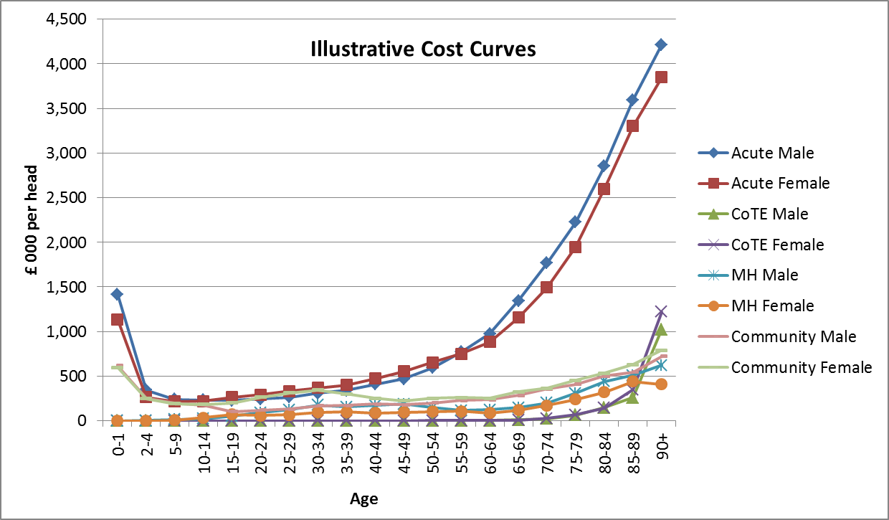
Structure: age and sex component

Slide 8
Structure: MLC component
Age & Sex Adjusted Activity
 |  |  |  |  |  |  |  |  |  |  | x |  | x
 |  |  |  |  |  |  |  | x |  | x |  |  | x
 |  |  | x | x |  | x | x |  | x |  | x | x |  | x
 |  | x |  | x | x |  |  | x
 | x |  | x |  | x | x |  |  |  |  |  | x
 |  | x
Change in activity
1
Change in ION
Indicators of need (SMR; LLTI)

Slide 9
Structure: MLC component
 |  |  |  |  |  |  |  | x
 |  |  |  |  |  |  | x |  | x
 |  |  |  | x |  | x |  | x | x
 |  |  |  |  | x |  |  | x
 |  |  |  |  |  | x
 |  |  |  |  |  | x
 |  | x |  | x
 |  | x
 | x |  |  | x |  | x
Activity
Indicators of need

Slide 10
Structure: MLC component
Activity
 |  |  |  |  |  |  |  |  |  | x |  | x
 |  |  |  |  |  |  | x |  | x |  |  | x
 |  | x | x |  | x | x |  | x |  | x | x |  | x
 | x |  | x | x |  |  | x |  | x |  | x | x
x |  | x |  | x | x | x
 | x
Indicators of need

Slide 11
Structure: unavoidable excess cost component
Ratio of local unit costs relative to national unit costs
Averaged across urban-rural geographies
Objective geographical classification - control for variation in efficiency

Slide 12
Structure: fusion
NRS population for small area
Age and Sex index value for that small area
Morbidity and Life Circumstances index value
Excess Cost index value for that urban-rural category
Weighted population for that small area
Sum by health board to get target shares
Small
area
Population
Age
& sex
index
Morbidity
& Life Cs
index
Excess
Cost
Index
Target
Share
%
X
X
X
⇨

Slide 13
Outputs: predicted need
Formula attributes health service use in the recent data to age, sex and socio-economic conditions – national average relationships
Need predicted by applying these national average relationships to local population characteristics and local socio-economic conditions

Slide 14
Outputs: magnitude of variation in indices …
Age
& sex
index
Morbidity
& Life Cs
index
Excess
Cost
index
Overall
index
Data Zone
0.52 | 0.71 | 0.97 | 0.41
2.07 | 1.85 | 1.38 | 2.18
0.96 | 0.90 | 0.98 | 0.91
1.12 | 1.10 | 1.20 | 1.29
Health Board

Slide 15
Outputs: published target shares (2016/17)
Health Board | Population Share¹ | Age-sex share | Age-sex and MLC share | Age-sex, MLC and excess cost share | + Age-sex, Additional needs, Excess cost share and Out of Hours adjustment
Ayrshire & Arran | 6.88% | 7.26% | 7.42% | 7.35% | 7.34%
Borders | 2.12% | 2.33% | 2.08% | 2.09% | 2.10%
Fife | 6.86% | 7.00% | 6.81% | 6.71% | 6.70%
Greater Glasgow & Clyde | 21.32% | 20.69% | 22.83% | 22.65% | 22.61%
Highland | 5.96% | 6.36% | 6.03% | 6.47% | 6.50%
Lanarkshire | 12.14% | 11.95% | 12.65% | 12.44% | 12.42%
Grampian | 11.00% | 10.74% | 9.89% | 9.92% | 9.94%
Orkney | 0.40% | 0.43% | 0.40% | 0.48% | 0.48%
Lothian | 16.21% | 15.50% | 14.82% | 14.67% | 14.66%
Tayside | 7.76% | 8.05% | 7.72% | 7.71% | 7.71%
Forth Valley | 5.64% | 5.60% | 5.51% | 5.43% | 5.43%
Western Isles | 0.50% | 0.56% | 0.55% | 0.67% | 0.67%
Dumfries & Galloway | 2.77% | 3.08% | 2.90% | 2.94% | 2.95%
Shetland | 0.43% | 0.44% | 0.40% | 0.48% | 0.48%

Slide 16
Development of the formula:
Formula maintained by Technical Advisory Group on Resource Allocation (TAGRA)
Analysis undertaken by Analytical Support Team (SG Health ASD and ISD) for working groups
Mental Health and LD MLC Sub-group
Remote and Rural Sub-group
Acute MLC Sub-group

Slide 17
Development of the formula: new index for MH
Old index:
    Proportion claiming Severe Disability Benefit
    Proportion of one person households
    Proportion in social rented housing
New index:
  Age cohort 65 and under:
    SIMD (employment)
    SIMD (crime)
    Hospital admissions due to alcohol
  Age cohort over 65:
    Hospital admissions due to alcohol
    Mental health deaths

Slide 18
Development of the formula: Remote and Rural Sub-gp.
Re-examined the unavoidable excess cost adjust.
Recommended a minor change to the Urban-Rural Classification to better reflect costs of SDIA areas
Introduced an adjustment to reflect the costs for boards providing Out of Hours GP services

Slide 19
Development of the formula: Acute MLC Review
Acute care programme accounts for 50% of the formula (£4bn)
7 diagnostic groups
Scope includes:
    costing methodology (incl. case mix adjustment)
    indicators of need
    unmet need
    granularity
    periodicity
    age split
Jan 2014 – August 2016
New formula will be used for 2018-19 allocation

Slide 20
Information
Working papers and minutes on TAGRA website:
http://www.tagra.scot.nhs.uk/
Formula target shares on ISD website:
http://www.isdscotland.org/Health-Topics/Finance/Resource-Allocation-Formula/resource-allocation-latest.asp

Slide 21
National Resource Allocation Formula
Technical Advisory Group on Resource Allocation
9th February 2016
Paudric Osborne
Lynne Jarvis

