Slide 1

NRAC: Population data available for 2025/26 formula run
PHS Health Finance Team, November 2023
Contact: phs.costsinfo@phs.scot

Slide 2
Overview
Where is population data used in the Formula?
What population data is needed?
Comparison of 2022 census results and 2021 population mid-year estimates (MYEs)
Reconsider what population data could be used in 2025/26 NRAC run
Further work
Discussion

Slide 3
Where is population data used in the Formula?
POPULATION
AGE SEX COMPOSITION
UNAVOIDABLE EXCESS COSTS OF SERVICE DELIVERY
MORBIDITY & LIFE CIRCUMSTANCES
NRAC Weighted Population (Share %)
Population data pivotal to these Formula components

Slide 4
Population share requirements
Age-sex requirements
Projections
Mid-year estimates
(NHS Board level)
Rebased population (NHS Board level)
Age-sex distribution from mid-year estimates (data zone)
Rebased population per NHS Board
Rebased population per data zone by age and sex
Population share

Slide 5
Mid-year estimate calculation
2011
census
2011
MYE
2012
MYE
2020
MYE
2021
MYE
Starting point
The census is used as the basis to calculate the MYEs with adjustments made each year for births, deaths and migration.

Slide 6
Difference between 2022 census and 2021 mid-year estimates
2022 census shows total Scotland population is 43,300 less than 2021 MYEs

Slide 7
+ 0.2%
- 0.2%

Slide 8
+ 0.6%
- 0.6%

Slide 9
+ 0.6%
- 0.6%

Slide 10
NRAC population requirements and data availability
Population dataset | Geography | Original proposal for 2025/26 NRAC run | What data is available near 2025/26 NRAC run?
Projections | NHS Board | 2018-based | 2018-based
Mid-year estimates | NHS Board | 2021
Mid-year estimates | Data zone | 2021

Slide 11
NRAC population requirements and data availability
Population dataset | Geography | Original proposal for 2025/26 NRAC run | What data is available near 2025/26 NRAC run?
Projections | NHS Board | 2018-based | 2018-based
Mid-year estimates | NHS Board | 2021 | 2022 data released by February 2024
Mid-year estimates | Data zone | 2021

Slide 12
NRAC population requirements and data availability
Population dataset | Geography | Original proposal for 2025/26 NRAC run | What data is available near 2025/26 NRAC run?
Projections | NHS Board | 2018-based | 2018-based
Mid-year estimates | NHS Board | 2021 | 2022 data released by February 2024
Mid-year estimates | Data zone | 2021 | 2022 data released summer 2024

Slide 13
NRAC population requirements and data availability
Population dataset | Geography | Original proposal for 2025/26 NRAC run | What data is available near 2025/26 NRAC run?
Projections | NHS Board | 2018-based | 2018-based
Mid-year estimates | NHS Board | 2021 | 2022 data released by February 2024
Mid-year estimates | Data zone | 2021 | 2022 data released summer 2024 but census data available by May 2024

Slide 14
Further work
PHS to continue to investigate population data and submit paper to TAGRA early next year:
  Summarise initial findings explained today
  Investigate rebasing populations at council area instead of NHS Board level
  Recommend an approach for the 2025/26 NRAC run
  Once population data to be used is agreed, calculate population shares for 2025/26 and share with TAGRA members

Slide 15
Discussion
Initial thoughts on items discussed today?
Do TAGRA agree that PHS should incorporate the 2022 census results as much as possible into the 2025/26 NRAC run?
Is it feasible to consider delaying the NRAC publication from May until July 2024 to allow us to apply the most up-to-date age-sex distribution (using the census data zone data?)
Any other questions?

Slide 16
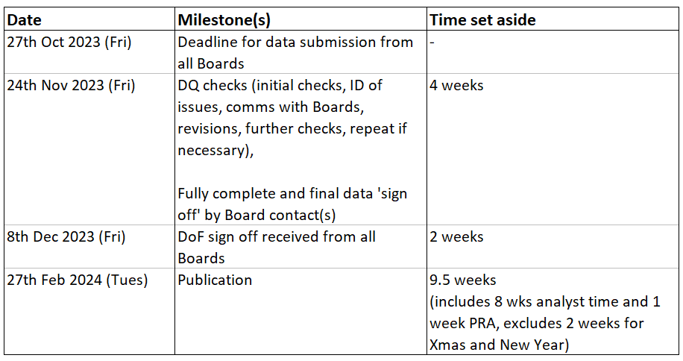
2022/23 Cost Book submission timescales

Slide 17
Submission progress
4 NHS Boards submitted by the 27th October deadline
As of 14th November:
  9 Boards have submitted all data and are being checked
  2 Boards have submitted partial data
  3 Boards have not yet submitted any data

