Slide 1
NRAC: Review of 2025/26 shares
PHS Health Finance Team, October 2024
Contact: phs.costsinfo@phs.scot

Slide 2
Key datasets used in 2025/26 NRAC run
POPULATION
AGE SEX COMPOSITION
UNAVOIDABLE EXCESS COSTS OF SERVICE DELIVERY
MORBIDITY & LIFE CIRCUMSTANCES
NRAC Weighted Population (Share %)
Rebased population calculated using 2022 MYEs and 2018-based projections.
Age/sex/data zone distribution calculated using 2022 census data.
Indicators of need based on 2022 census data and MYEs from older years that have not yet been adjusted based on the 2022 census.
For 2025/26, the indices produced at the last Excess Cost update (2022/23 NRAC) were used. Excess Cost was initially run using the most recent data available but resulted in significant changes in the outputs compared to previous years which requires investigation.
Patient activity costed using 2022/23 SMR and Cost Book data.
Patient activity costed using 2018/19, 2019/20 and 2022/23 SMR and Cost Book data.

Slide 3
Formula components updated in recent NRAC runs
NRAC year | Formula components updated
2022/23 | Full update
2023/24 | Population share, Age-Sex
2024/25 | Population share
2025/26 | Population share, Age-Sex, MLC
There should be a full update of the formula every three years with partial updates in between.
Normal update schedule affected by the impact of the pandemic on data availability.
Need to take into account which components were updated in each year when interpreting trends in shares/indices across years.

Slide 4
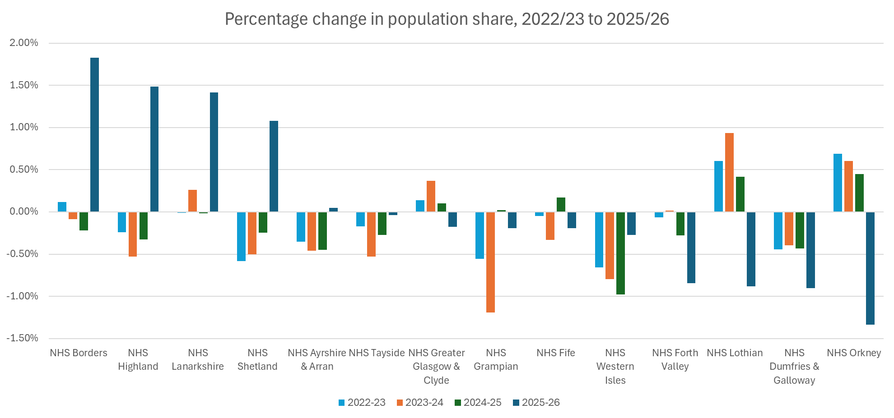

Slide 5
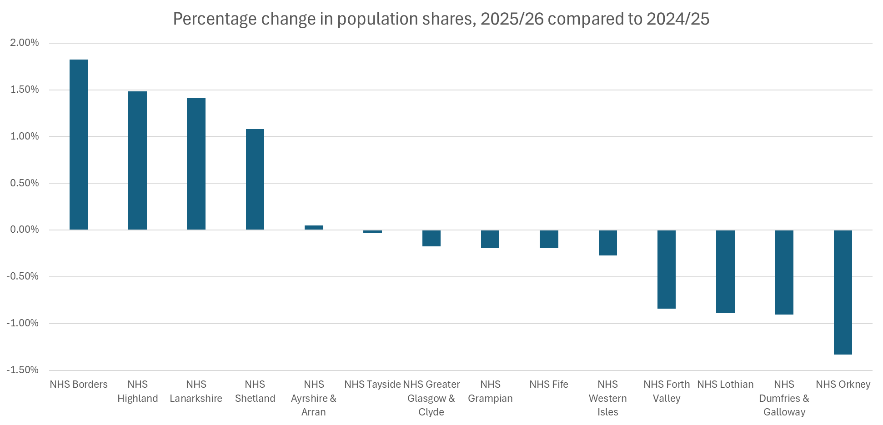

Slide 6
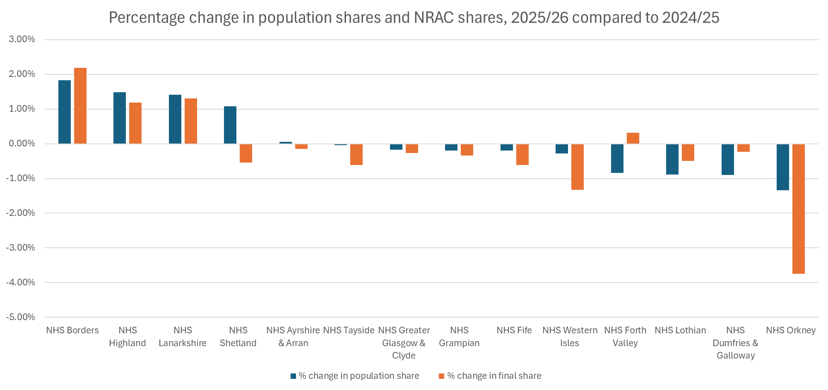

Slide 7
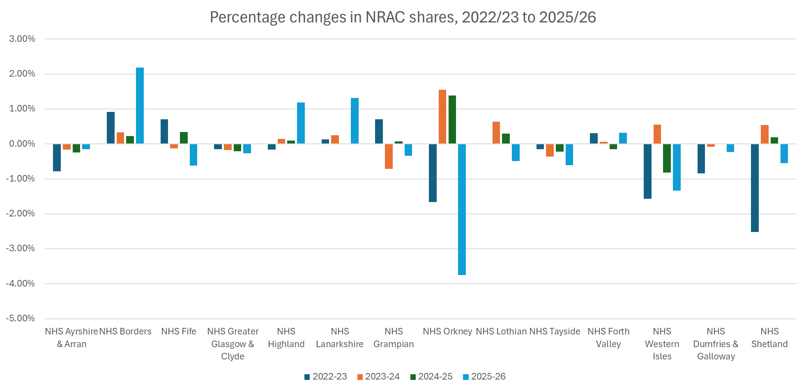

Slide 9
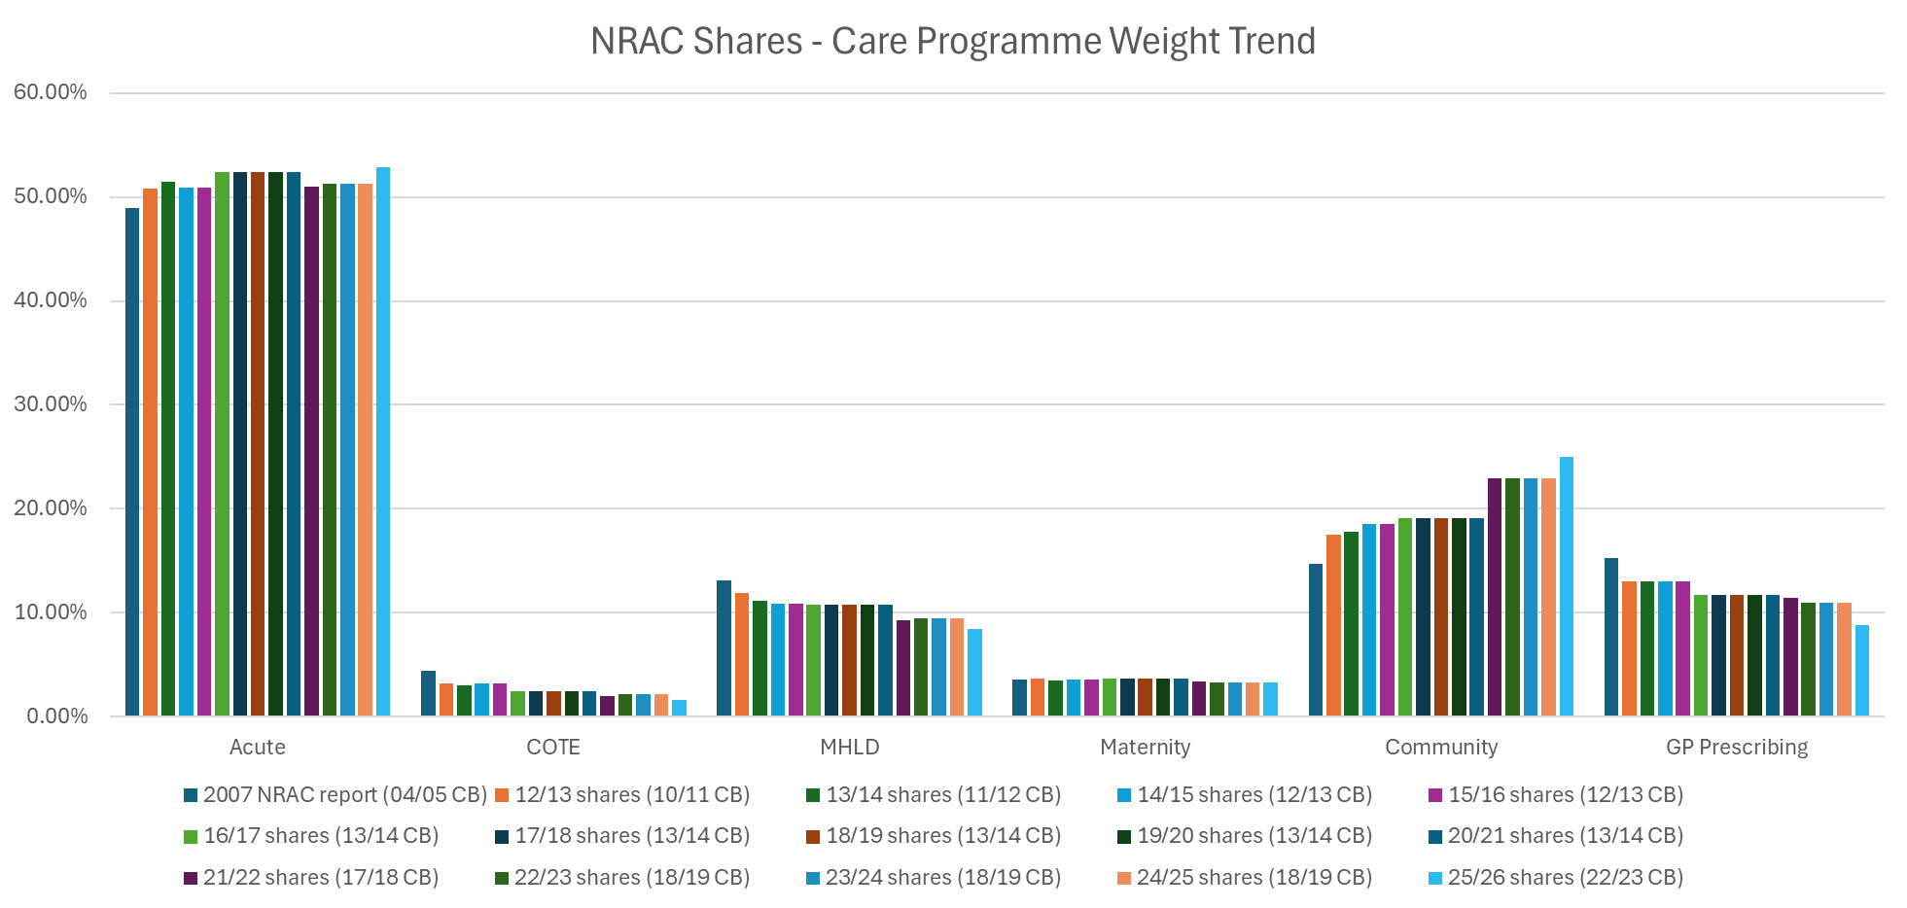
Notes:
Weights are calculated based on the proportion of expenditure in each sector (submitted for the Cost Book publication).
At times, multiple NRAC runs used the same year of data from Cost Book. Various reasons for this e.g. it was decided to move to producing NRAC shares three years in advance of the allocation year, at which point three years of shares were released at the same time. The NRAC care programme weights for those shares were all based on the same Cost Book year.

Slide 10
Excess Cost – 2025/26 NRAC run
Excess Cost definition: “Gives greater weight to areas where there is evidence of unavoidable excess costs of supplying healthcare services.”
The indices produced at the last Excess Cost update (2022/23 NRAC) were used for the 2025/26 run. Excess Cost was initially run using the most recent data available but resulted in significant changes in the outputs compared to previous years.
Excess Cost relies on unit costs derived from expenditure and activity data from the Cost Book.
NHS boards submit activity data for Cost Book using a variety of data sources.
Inaccurate activity could be causing an issue by skewing the unit cost and leading to significant changes in the Excess Cost outputs.
Requires a much more thorough investigation to identify the problem.

